Slide 1


Product Catalog
12/02/2025
Rajesh Krishnappa
Software Design Trainee

Slide 2

Agenda
Problem Statement
Project Overview
System Architecture
User Workflow
Admin Workflow
Technologies used
Database Design
Backend Implementation
Frontend Implementation
Screenshots
Conclusion
Problem Statement
WinWire © 2025, All Rights Reserved.

Slide 3
Problem Statement
“E-commerce-style catalog to display products.”
Organizations need an efficient way to present products to customers while allowing administrators to easily manage product information. Manual catalog management is slow, error-prone, and difficult to scale. Users also expect quick searching, filtering, and browsing features in modern systems.
Objectives :
Provide a clean and user-friendly interface for browsing products.
Enable quick search, filtering, and pagination for better user experience.
Allow Admins to add, update, and delete products and categories easily.
Implement secure login and role-based authorization.
Build a scalable full-stack solution using .NET Core Web API and React JS.
WinWire © 2025, All Rights Reserved.

Slide 4
Project Overview
The Product Catalog Management System enables user to browse products with search by keyword, filtering by price/category, and pagination, while allowing administrator to securely manage the product catalog by adding, editing and deleting the products. The system provides authentication and authorization based on roles, which leads to role-based dashboards, and an intuitive interface for both users and admin. The backend is built using .NET Core Web API with a SQL server database and the frontend is built using React JS for a modern, responsive user experience.
Purpose and Scope:
To provide the centralized platform for managing the product information efficiently.
To offer customers a simple and fast way to browse and explore products with search and filters.
To allow admins to add, update, delete the product and their categories.
To build a scalable, secure, real-world-ready solution using industry-standard full-stack-technologies.
WinWire © 2025, All Rights Reserved.

Slide 5
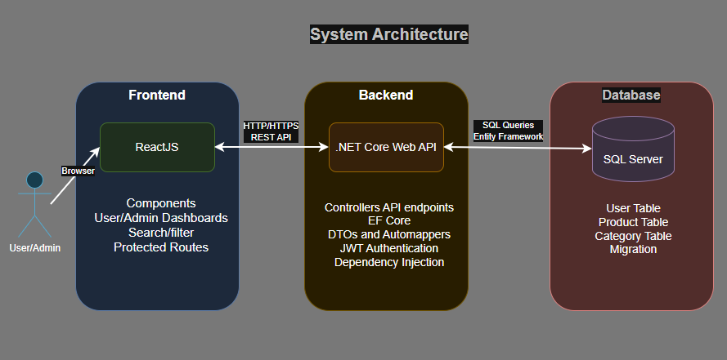
System Architecture
React UI Communicates with the backend using Rest APIS.
Backend handles business logic, Authentication, and database access.
SQL server stores all persistent data using EF Core and migrations.
WinWire © 2025, All Rights Reserved.

Slide 6
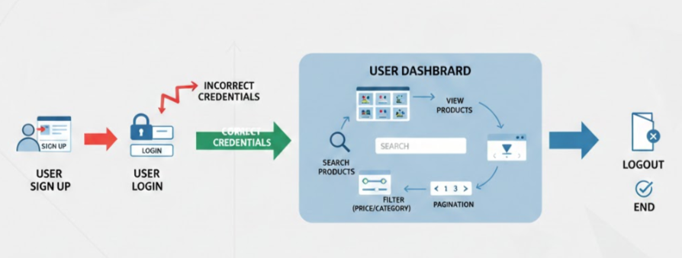
User Workflow
User completes the Signup process, followed by Login where credentials are used to gain secure access to the system.
Upon successful authentication, the user lands on the User Dashboard, which serves as the central hub for product interaction.
The user views the main Product List and can utilize a Search function to quickly locate specific items.
The user actively Filters the product list by criteria like price or category and uses Pagination to navigate through results.
The user securely ends their session by initiating the Logout process.
WinWire © 2025, All Rights Reserved.

Slide 7
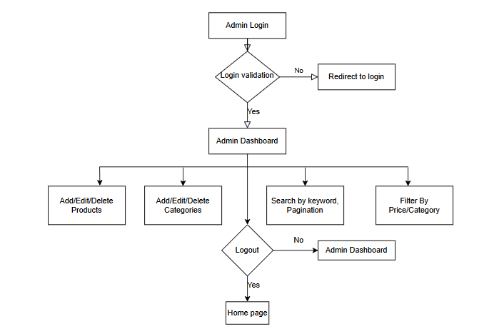
Admin Workflow
The Admin must successfully Login via a validation process to gain access to the secure Admin Dashboard.
From the dashboard, the Admin can perform all essential CRUD (Create, Read, Update, Delete) operations on Products and Categories, utilizing Search, Filter, and Pagination tools to manage the lists efficiently.
After completing tasks, the Admin ensures system security by initiating and confirming Logout, which terminates the session.
WinWire © 2025, All Rights Reserved.

Slide 8






Technologies
Frontend Technologies
React JS–Component based UI framework
React Router DOM-Navigation and routing
Context API- State Management
Axios-HTTP request to backend
HTML5,CSS,JavaScript(ES6)
Backend Technologies
.NET Core Web API-RESTful API development
Entity Framework Core(Code-first)-ORM for database operations
Auto Mapper-Mapping between Models and DTOs
JWT Authentication-Secure login and role-based access
CORS-Communication between React and .NET backend
Database
SQL Server-Persistent User, Product and Category Data
EF Core Migrations-Database schema creation and updates
WinWire © 2025, All Rights Reserved.

Slide 9
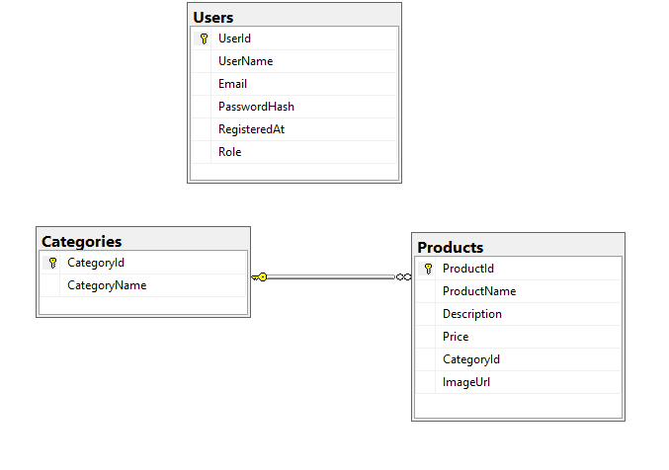
Database Design
The database consists of three main tables — Users, Categories, and Products — designed using the Entity Framework Core Code-First approach . It supports user authentication, role-based access, and category-based product management.
Products Table : Stores product information such as name, description, price, and image URL. The CategoryId field establishes a one-to-many relationship with Categories.(1 Category – Many products)
Users Table : Stores all registered users, including both Admin and Customers. Role-based authorization is handled at the API level, so the Users table remains independent.
Categories Table : Maintains product categories. Each category can have multiple products.
WinWire © 2025, All Rights Reserved.

Slide 10
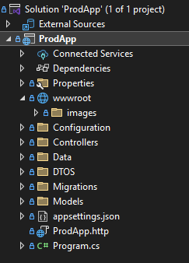
Backend Implementation
Structured Project Setup: Created Models, DTOs, Data (DbContext & Configurations), Controllers, and wwwroot/images folder for clean architecture.
Entity Framework Core (Code-First): Configured DbContext, created migrations, and generated database tables for Users, Products, and Categories.
RESTful API Development: Implemented separate controllers for Authentication, Users, Products, and Categories to support CRUD operations.
JWT Authentication & Role-Based Access: Enabled secure login and restricted admin operations using JWT tokens and role validation.
Configuration & Dependency Injection: Added required services (DbContext, AutoMapper, JWT, CORS) in Program.cs and linked the database using appsettings.json.
Swagger UI for testing the backend API end points.
WinWire © 2025, All Rights Reserved.

Slide 11
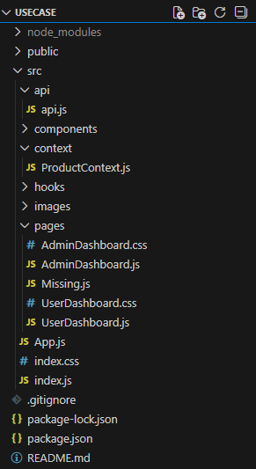
Frontend Implementation
Component-Based Structure: Organized the project into components/, pages/, context/, and api/ folders with separate CSS files for each UI component.
Routing & Navigation: Used React Router DOM to build navigation for Login, Signup, User Dashboard, Admin Dashboard, and protected routes.
State Management with Context API: Managed global data such as products, search values, filters, and auth details using React Context for clean state flow.
REST API Integration: Connected to the .NET backend through a centralized Axios instance (api.js) to handle all CRUD, search, and authentication requests.
UI Features: Implemented search, filter, pagination, product viewing, and admin CRUD features with reusable components like ProductCard, ProductList, and Pagination.
WinWire © 2025, All Rights Reserved.

Slide 12
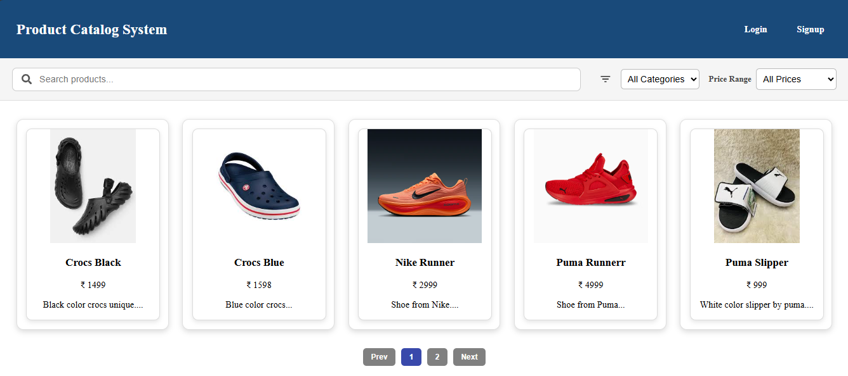
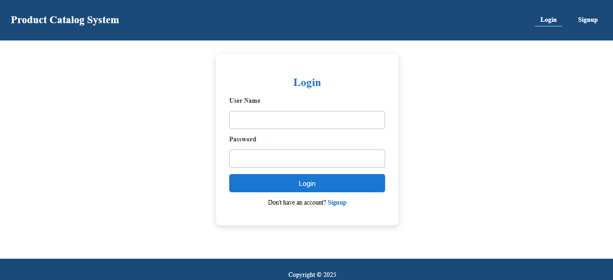
Screenshots
WinWire © 2025, All Rights Reserved.

Slide 13
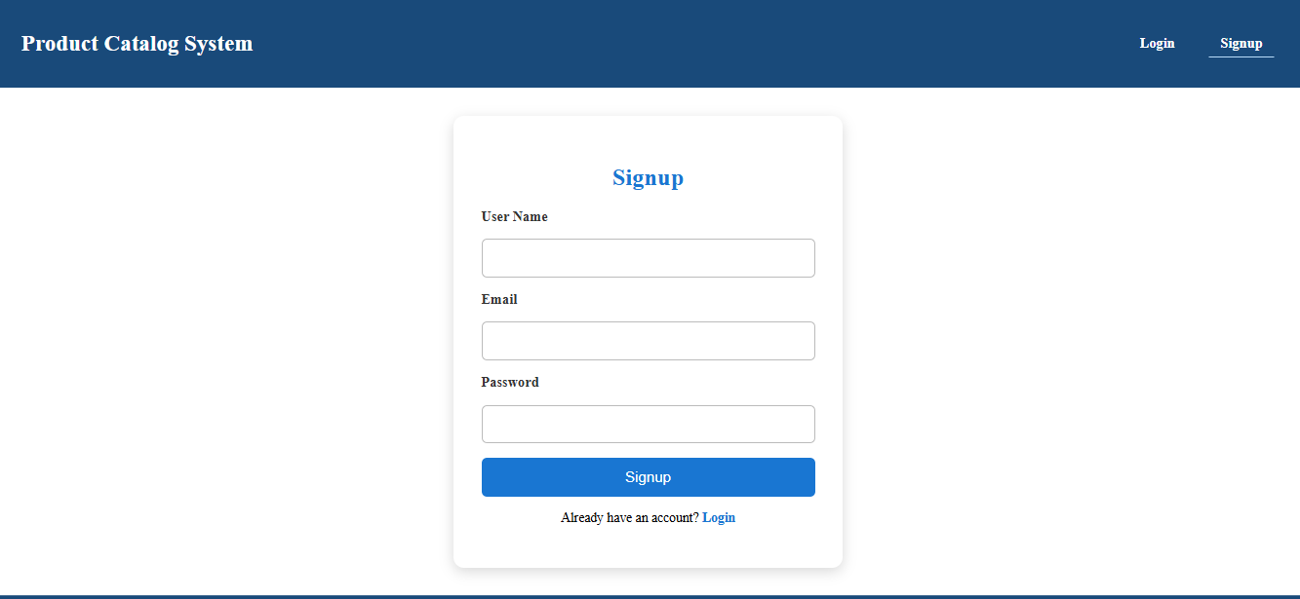
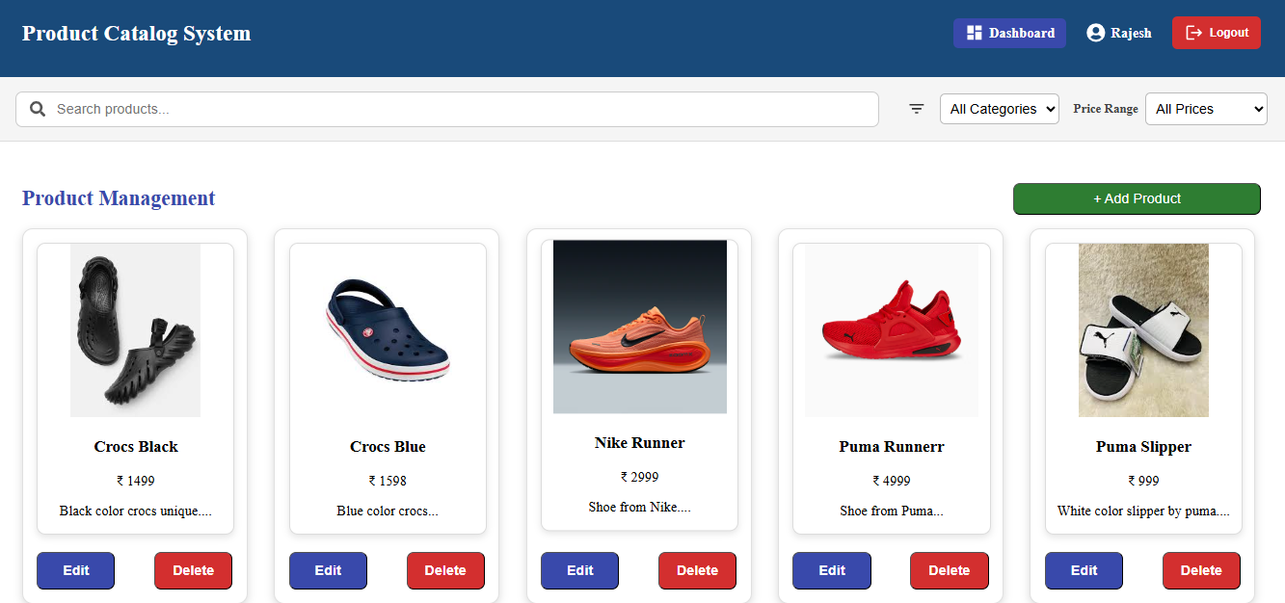
WinWire © 2025, All Rights Reserved.

Slide 14
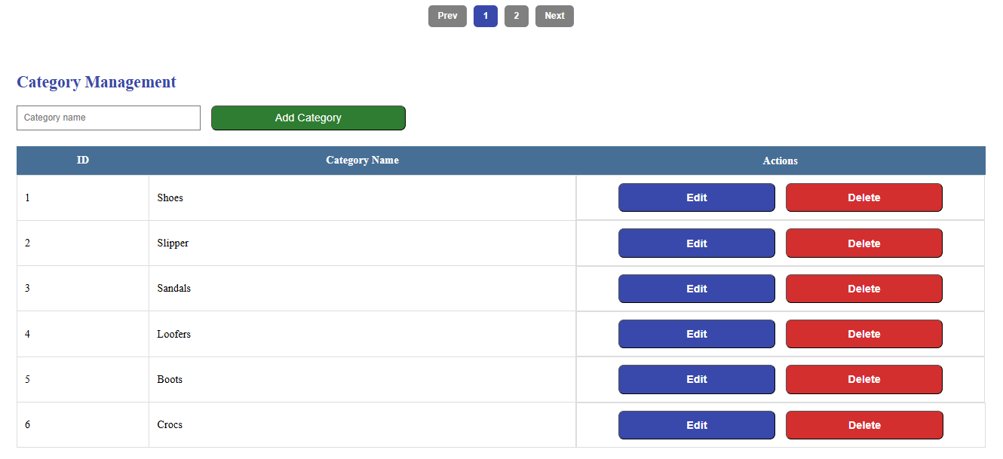
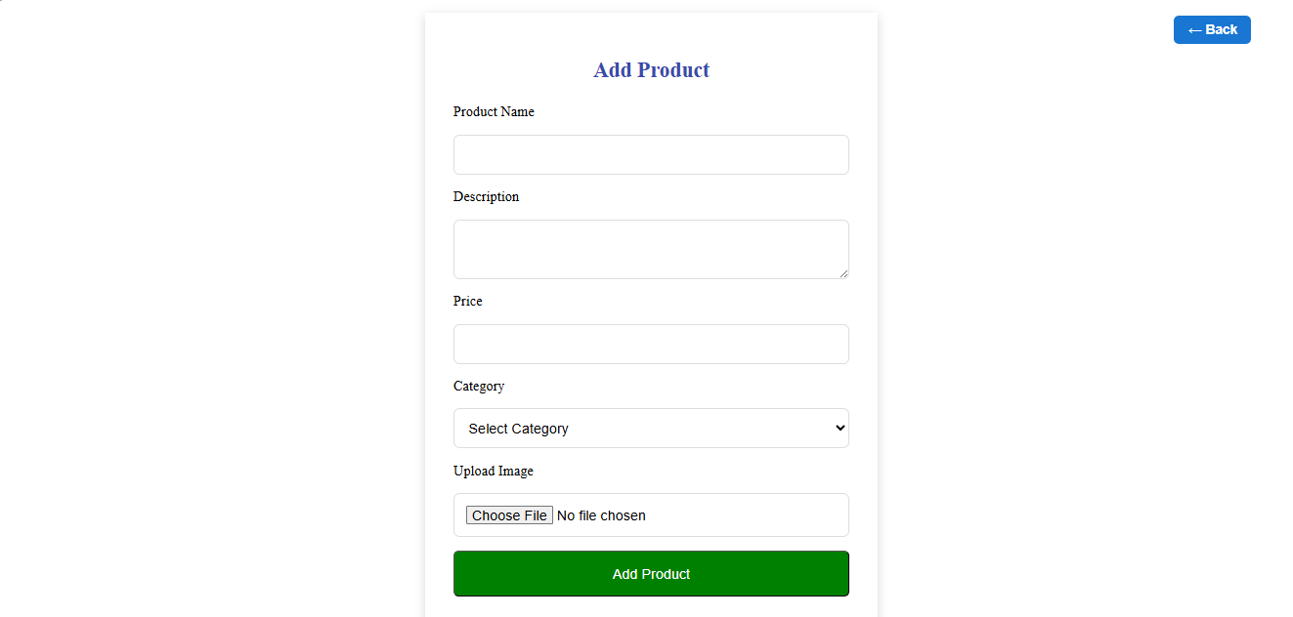
WinWire © 2025, All Rights Reserved.

Slide 15
Conclusion
This project delivers a complete, secure, and user-friendly Product Catalog Management System supporting both customer browsing and admin-level catalog control. By integrating .NET Core Web API, React JS, and SQL Server, the system ensures efficient data handling, responsive design, and reliable role-based access.
WinWire © 2025, All Rights Reserved.

Slide 16
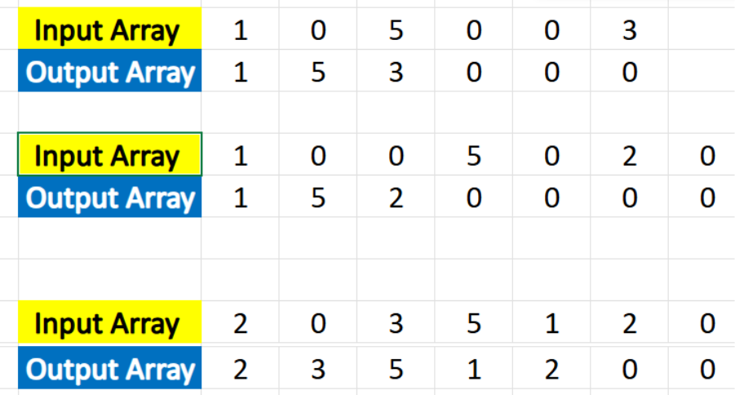
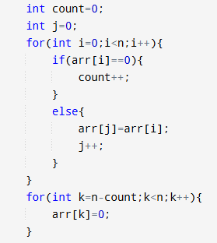
Problem Statement
WinWire © 2025, All Rights Reserved.

Slide 17

Right Brain Revolution
#RightBrainRevolution
17

